Slide 1
Network Stack Tester
(NeST)

Slide 2
What is NeST?
A Python package to emulate networks
Uses network namespaces to simplify the process of setting up networks
Provides intuitive APIs to
Build a virtual network topology
Run experiments on the virtual network topology
Collect statistics
Plot results

Slide 3
Why NeST?
Simplifies the process to reproduce network experiments
Less physical resources, less error prone and less prerequisites
Multiple instances of the same network topology can co-exist, and different experiments can be run in parallel on every instance
NeST assigns random names to the network namespaces
Cleans up the environment (deletes network namespaces) on termination
Open source tool released under GPLv2 License

Slide 4
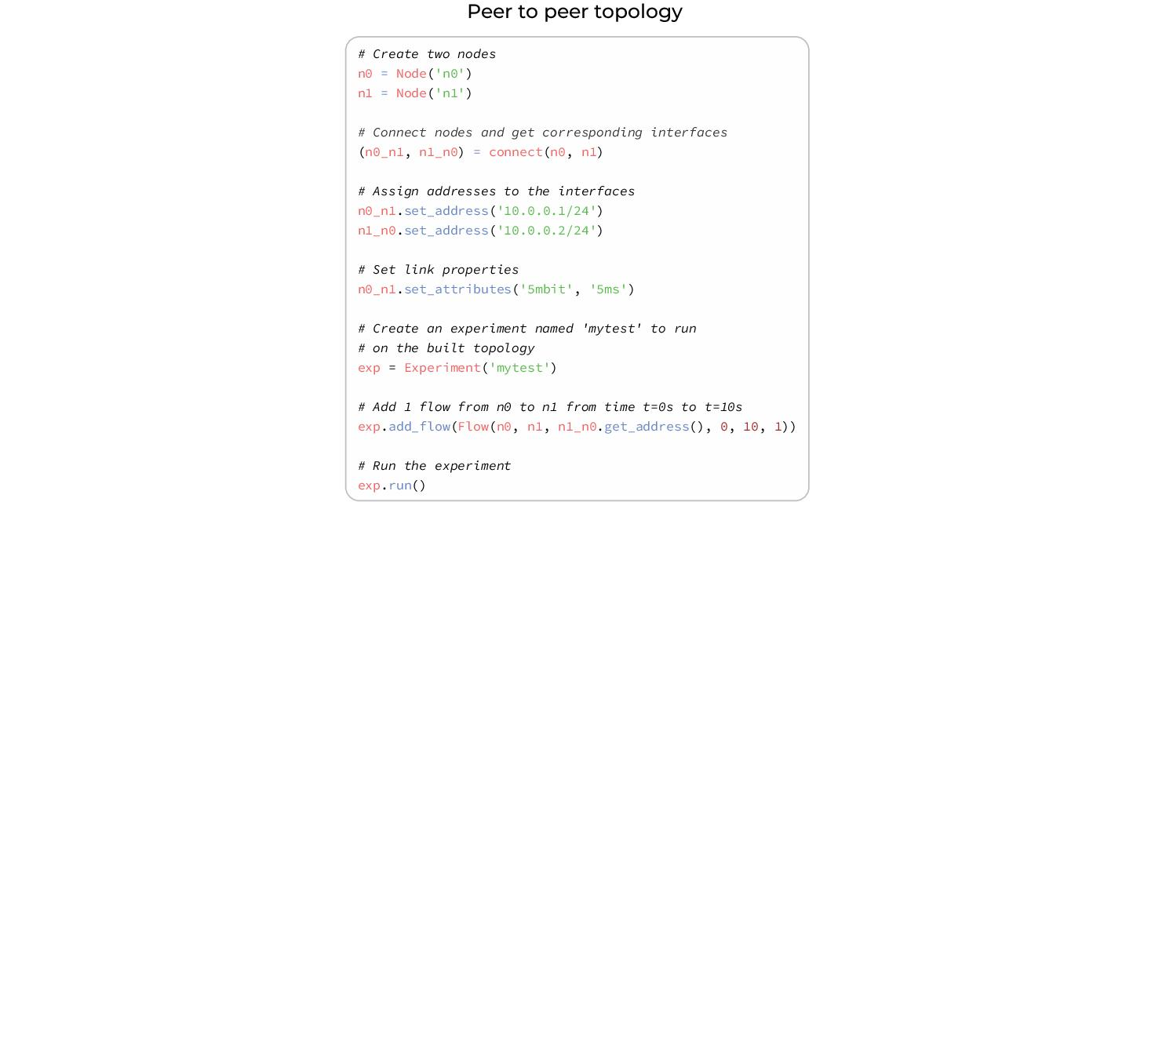

Slide 5
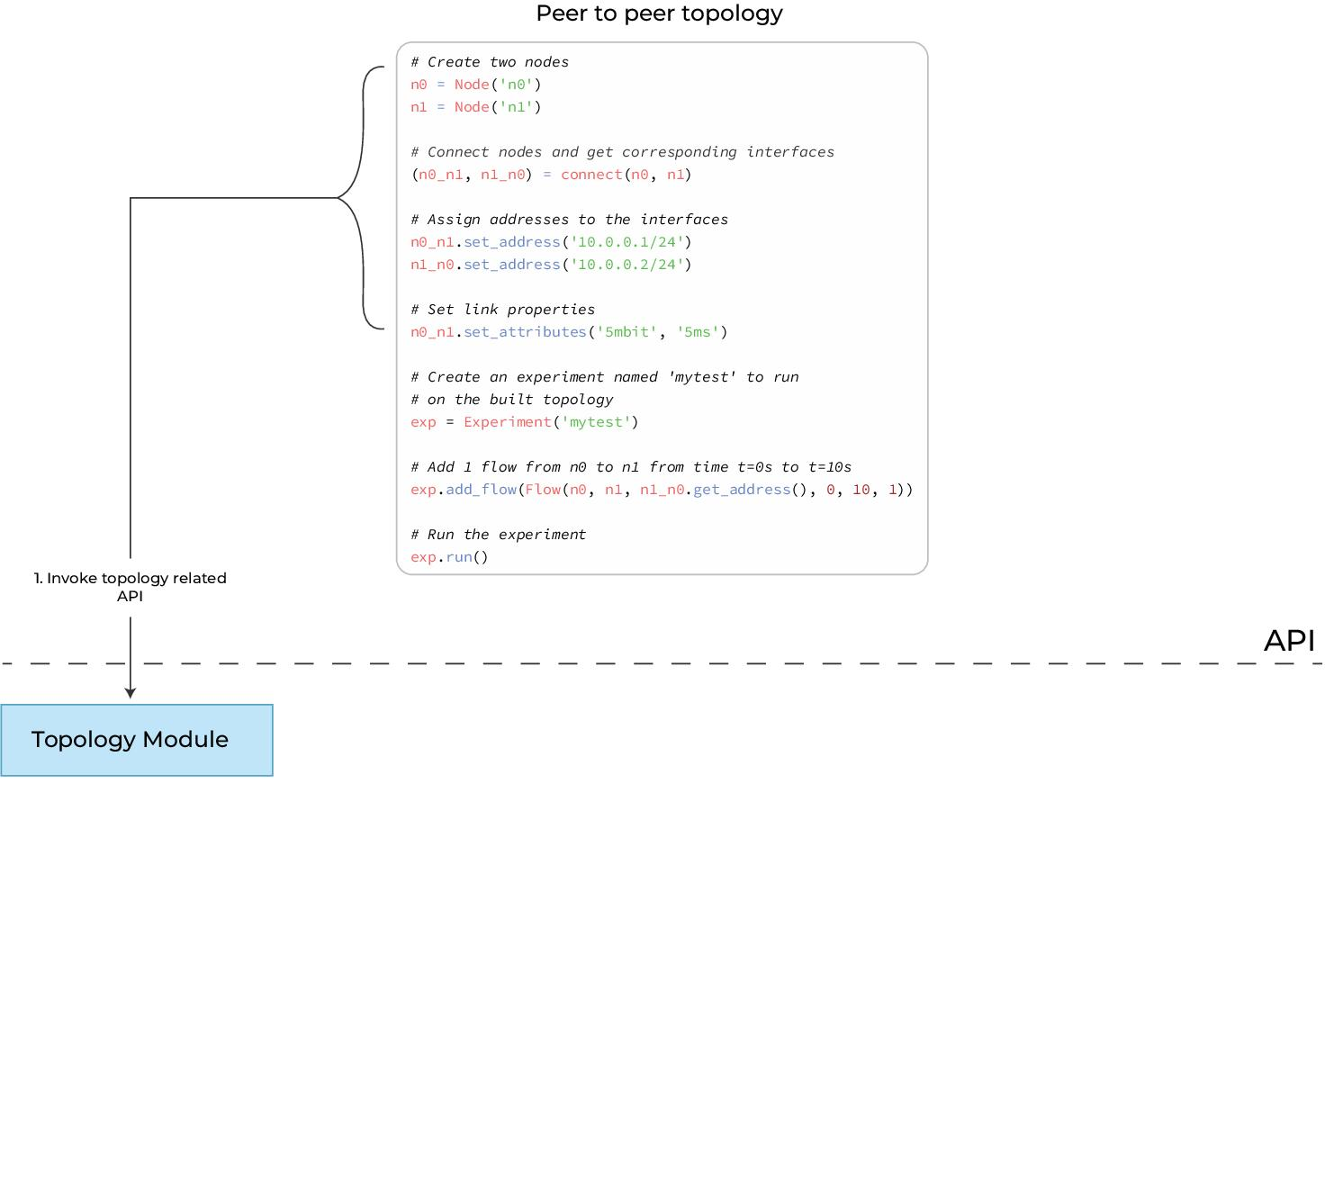

Slide 6
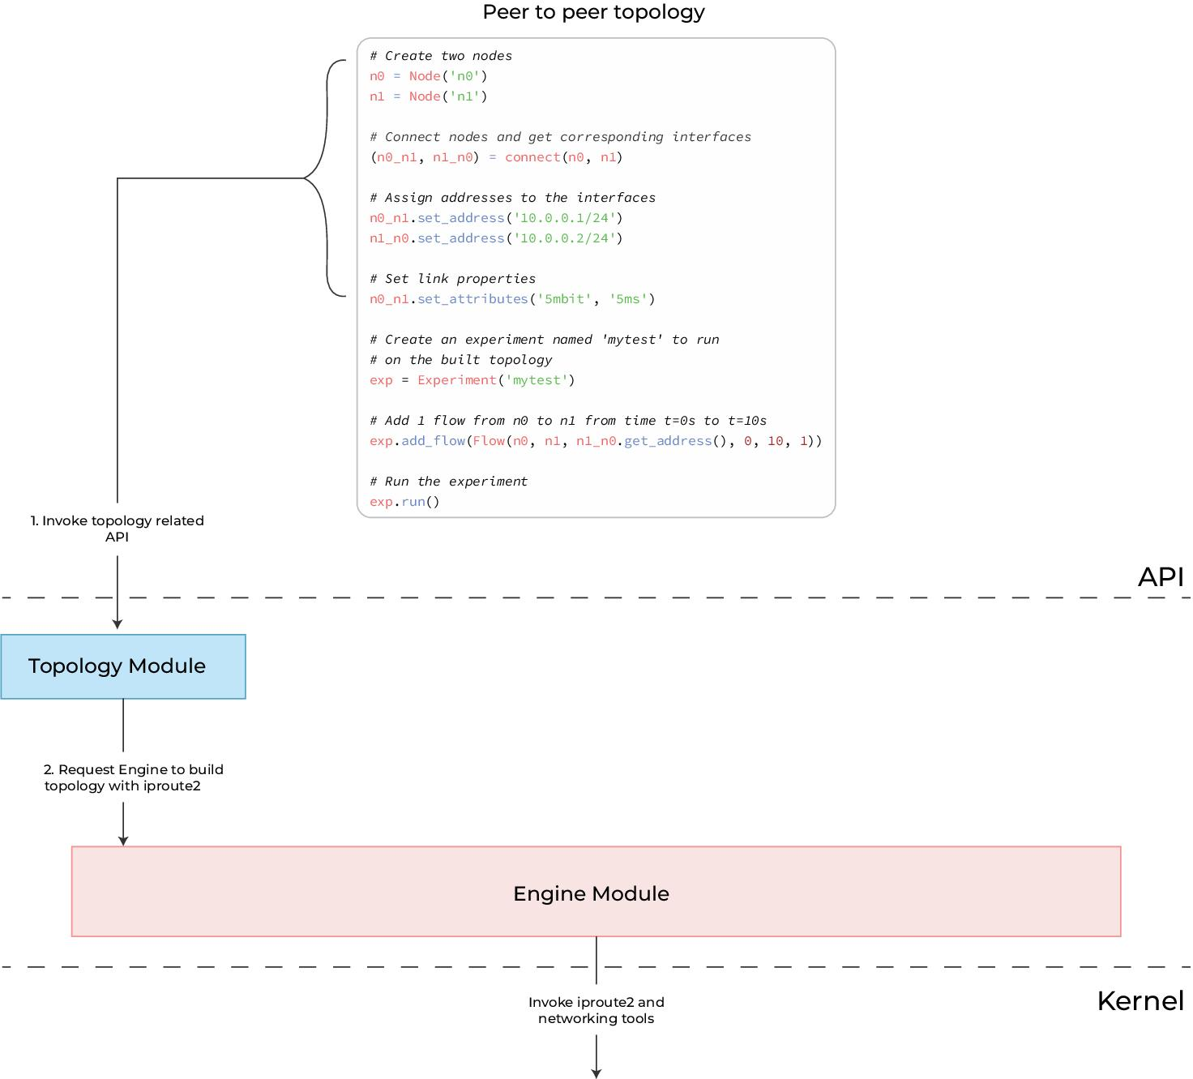

Slide 7
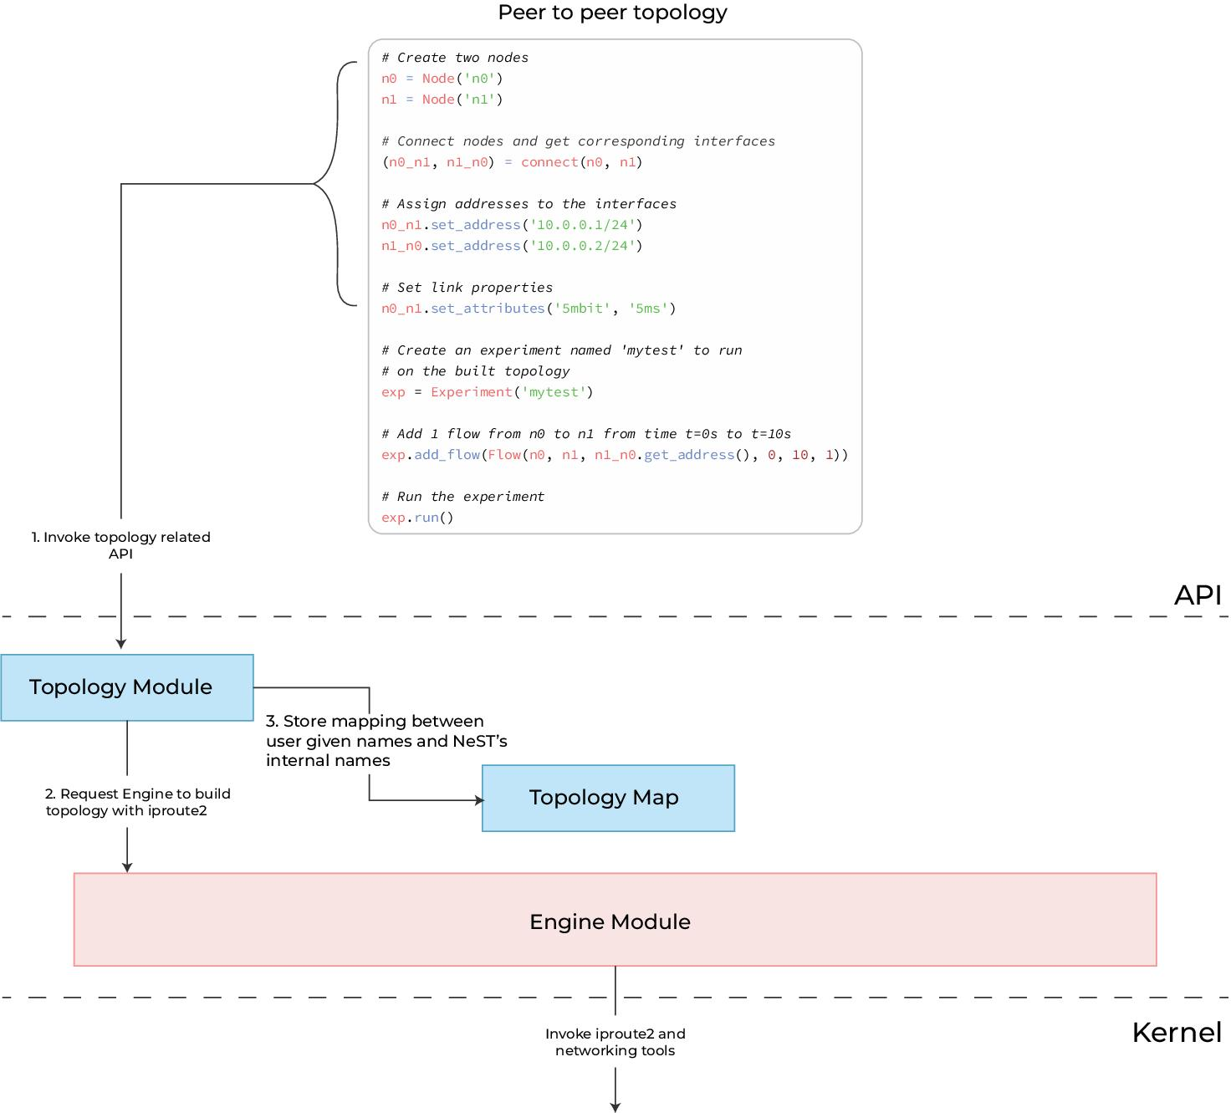

Slide 8
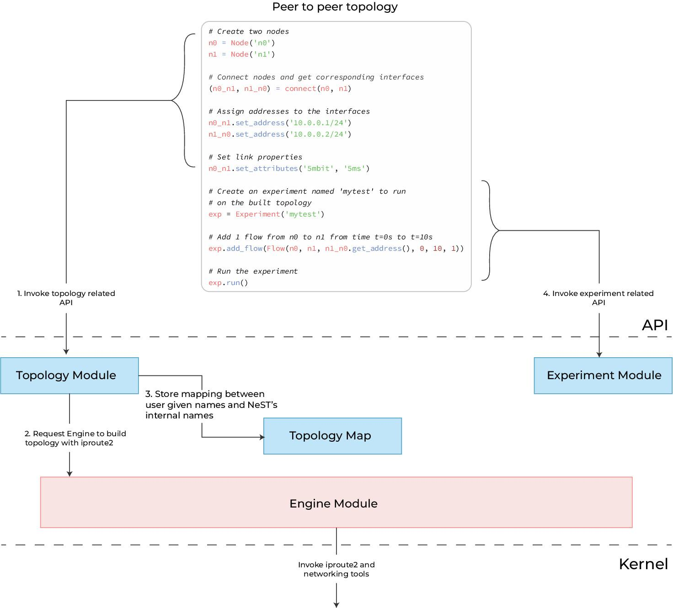

Slide 9
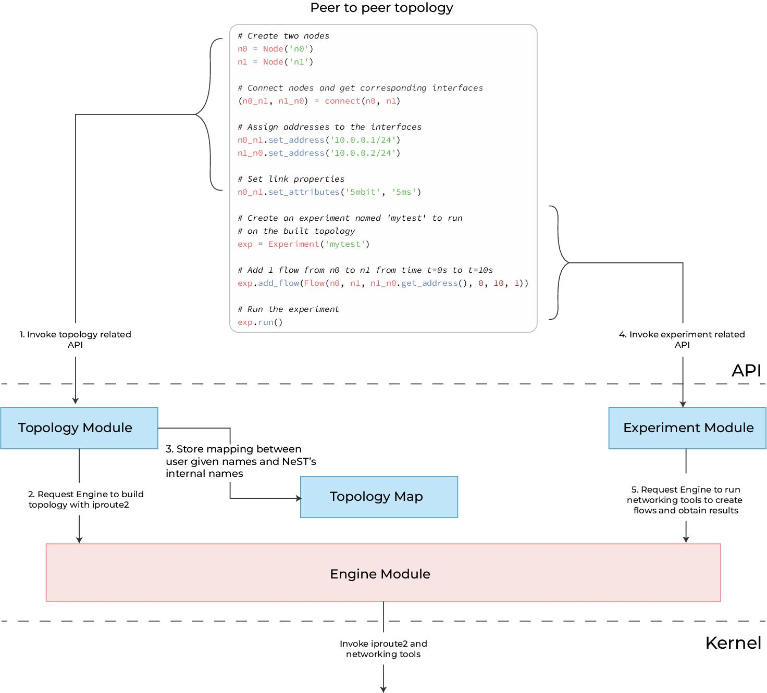

Slide 10
